Slide 1
USB Mouse
Using Arduino Micro and Accelerometer MPU6050

Slide 2
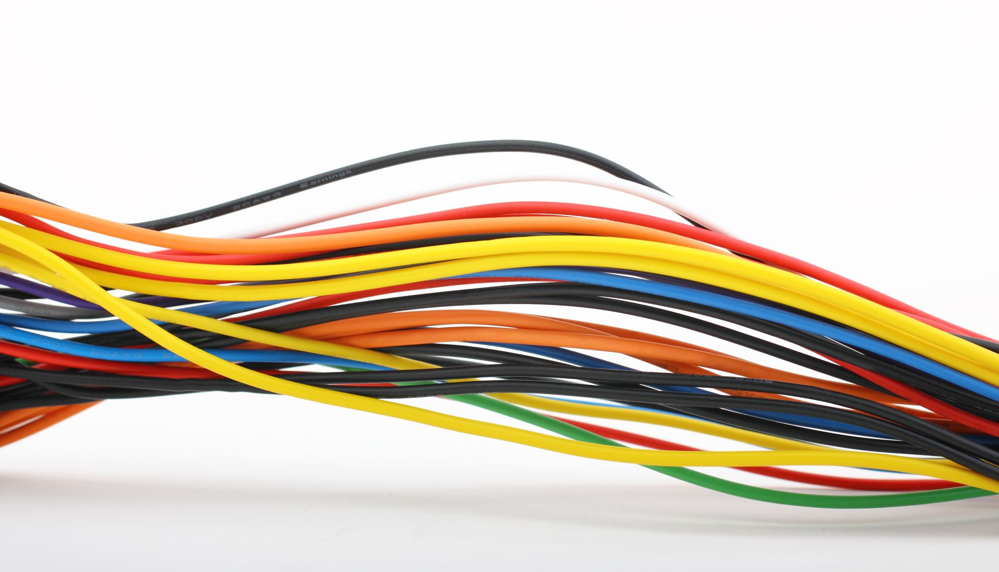

Parts Needed
Arduino Pro / Pro micro / Leonardo
Any Arduino with built-in USB Microcontroller (atmega32u4)
MPU6050 accelerometer
2 x Push Button switches
1 x MicroUSB Cable
Connecting wires
Breadboard

Slide 3
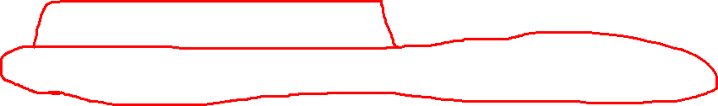
Arduino
Latest 2.x Version Arduino
Download the MPU6050 library (electronics cats)

Slide 4
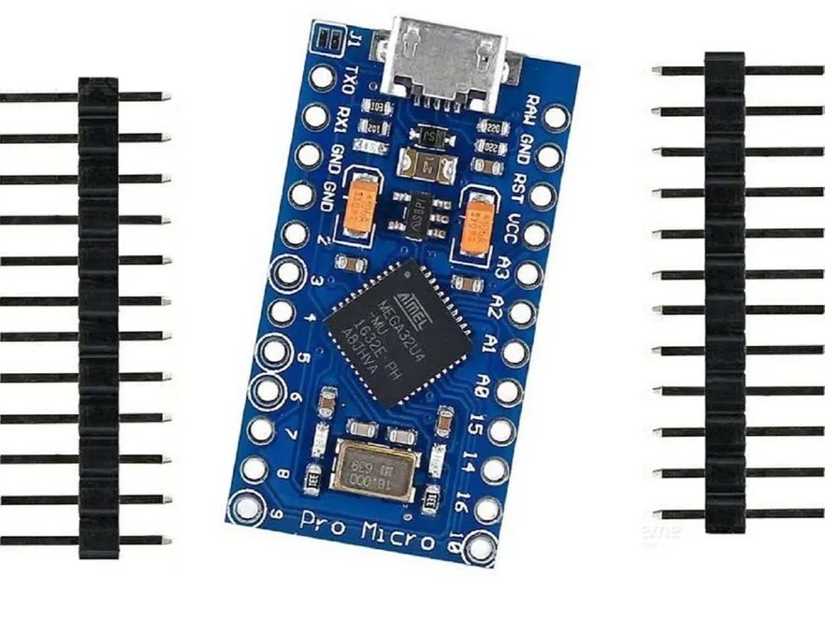
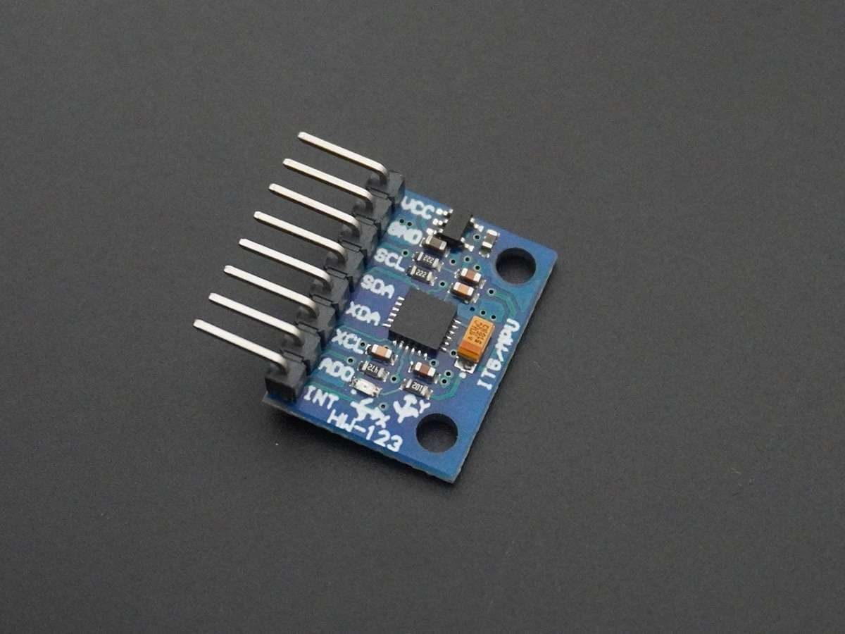
Major Parts

Slide 5
